Slide 1
Review Exercise 5
Given a sequence of numbers inputted by the user compute the following statistics:
min,
max,
average,
number of duplicates, and
mode.
You should define a function for each one of these statistics.
TIP: these functions should take as input a sequence of numbers.
Notes:
0

Slide 2
Solution
print('Describe My Sequence (0.1)')
# functions go here
n = int(input('How many values? ')) l = [] for i in range(n): v = float(input('Insert number ' + str(i + 1) + ': ')) l.append(v) print('The statistics are:') print('* Min:', min(l)) print('* Max:', max(l)) print('* Avg:', average(l)) print('* Dup:', duplicates(l)) print('* Mod:', mode(l))
Notes:
1

Slide 3
Solution (I)
def min(vs): res = vs[0] for v in vs[1:]: if v < res: res = v return res
1
5
-2
5
10
12
Notes:
2

Slide 4
Solution (II)
def max(vs): res = vs[0] for v in vs[1:]: if v > res: res = v return res
1
5
-2
5
10
12
Notes:
3

Slide 5
Solution (III)
def average(vs): res = 0 for v in vs: res = res + v res = res / len(vs) return res
Notes:
4

Slide 6
Solution (IV)
def duplicates(vs): s = set() res = 0 for v in vs: if v not in s: s.add(v) else: res = res + 1 return res
Notes:
5

Slide 7
Solution (V)
def mode(vs): f = {} for v in vs: if v not in f: f[v] = 0 f[v] = f[v] + 1 res = vs[0]
m = f[res] for k, v in f.items(): if v > m: res = k
m = v return res
1:1
5:2
1
5
-2
5
10
12
-2:1
5
vs
10:1
res
f
12:1
Notes:
6

Slide 8
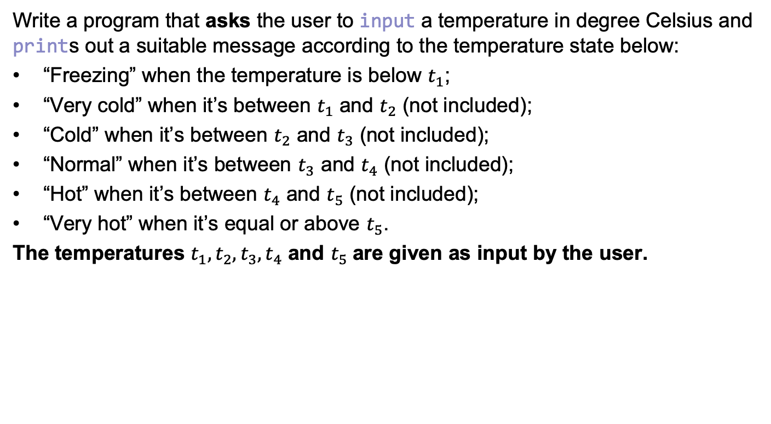
Review Exercise 6
Write a program that asks the user to input a temperature in degree Celsius and prints out a suitable message according to the temperature state below:
“Freezing” when the temperature is below $t_{1}$;
“Very cold” when it’s between $t_{1}$ and $t_{2}$ (not included);
“Cold” when it’s between $t_{2}$ and $t_{3}$ (not included);
“Normal” when it’s between $t_{3}$ and $t_{4}$ (not included);
“Hot” when it’s between $t_{4}$ and $t_{5}$ (not included);
“Very hot” when it’s equal or above $t_{5}$.
The temperatures $t_{1}, t_{2},t_{3},t_{4}$ and $t_{5}$are given as input by the user.
Notes:
7

Slide 9
Solution
print('Temperature to Perceived Temperature Converter (0.3)') perceived_temps = ['freezing', 'very cold', 'cold', 'normal', 'hot', 'very hot'] temps = [] for i in range(5): temp = float(input('To which temperature you feel like is no longer ' + perceived_temps[i] + '? ')) temps.append(temp) temp = float(input('What temperature is outside? ')) perceived_temp = perceived_temps[-1] not_found = True i = 0 while not_found and i < len(temps): if temp < temps[i]: perceived_temp = perceived_temps[i] not_found = False i = i + 1 print('Your temperature today is', perceived_temp)
for i in range(len(temps)): if temp < temps[i]: perceived_temp = perceived_temps[i] break
Notes:
8

